Slide 1
Appendix B Analysis of HH103ΩNopAA and HH103ΩRhcN by Southern blot.
A, Lane 1: The genome of HH103ΩNopAA was digested by EcoRI; Lane 2; The genome of the wild strain HH103 was digested by EcoRI; Lane 3: The genome of HH103ΩNopAA was digested by MluI; Lane 4: The genome of the wild strain HH103 was digested by MluI. B, Lane 1: The genome of the wild strain HH103 was digested by HandIII; Lane 2: The genome of HH103ΩRhcN was digested by HandIII; Lane 3: The genome of the wild strain HH103 was digested by SacI; Lane 4: The genome of HH103ΩNopAA was digested by SacI

Slide 2
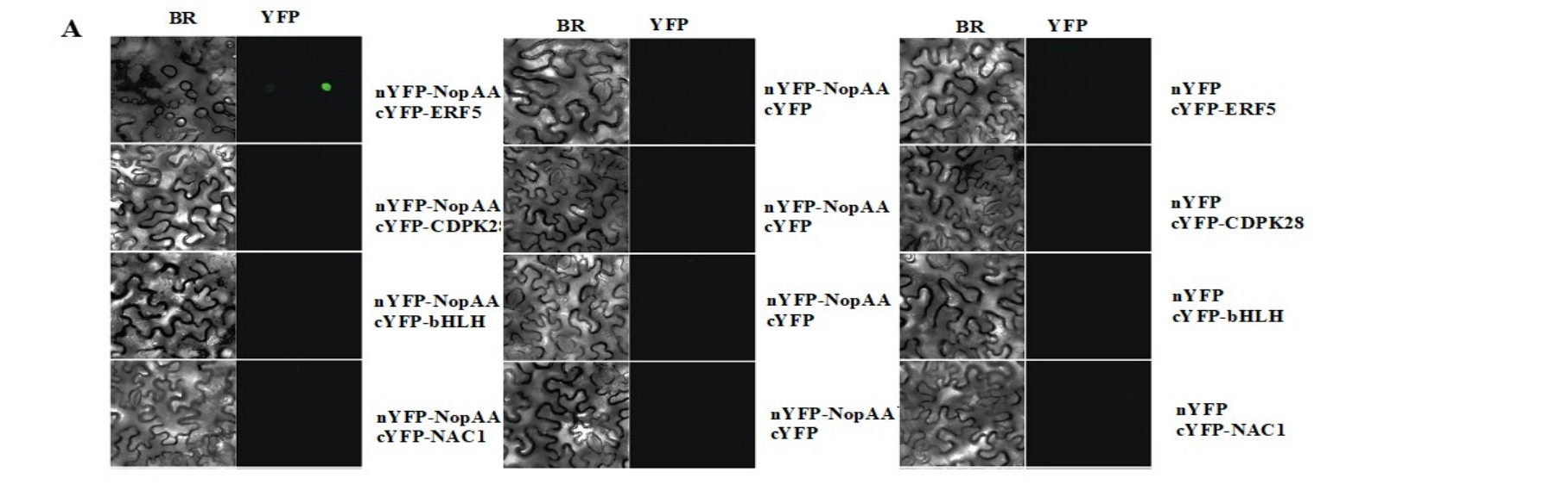
Appendix C Bimolecular fluorescence complementation (BiFC) analyses to validate interactions among NopAA, GmERF5, GmCDPK28, GmNAC1, and GmbHLH. Agrobacterium strains harboring different BiFC fusion plasmids (as indicated above each image) were co-infiltrated into Nicotiana benthamiana leaves to test interaction. BF, bright field; YFP, Yellow Fluorescent Protein.

Slide 3
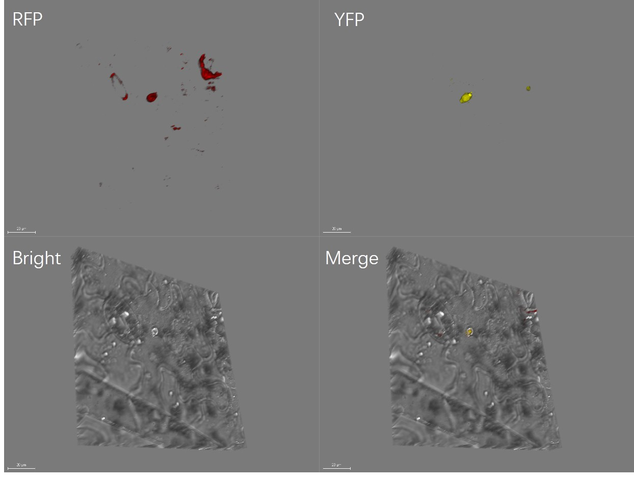
Appendix D Z-stack analysis of nYFP-NopAA cYFP-ERF5interaction，AtAHL22 was used as a nuclear marker

